Slide 1
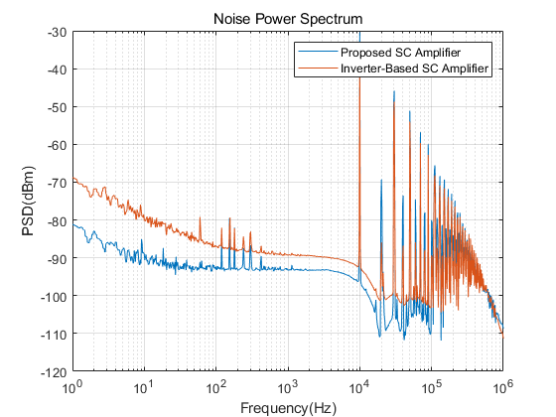
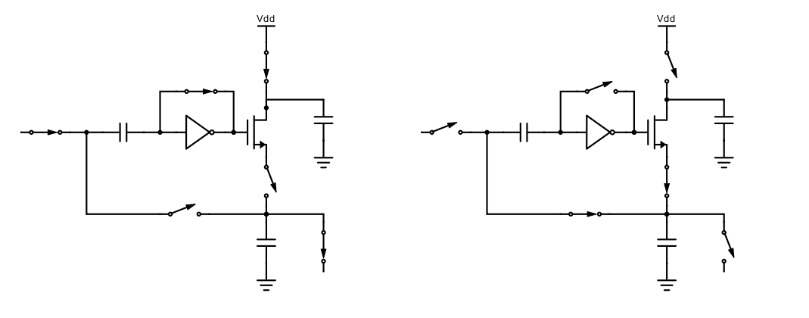
Noise Characteristics of the Charge Sharing Inverter-Based Switched-Capacitor Amplifier
Kiwon Seo, Gunhee Han
School of Integrated Technology, Yonsei University
Abstract
This research presents a new type of switched-capacitor amplifier, which operates without virtual ground and using auto-switched charge sharing . The proposed architecture achieves 13dB and 4dB advanced noise performances at 1Hz and 1KHz compared to the inverter-based switched capacitor amplifier. Proposed and compared amplifiers are fabricated in a 180nm CMOS technology and consuming 12.6uW and 12.4uW from 1.8V supply.
Proposed Scheme
Experimental Results
Phase 1
$$C_{3}$$
$$Ø_{1}$$
Phase 2
$$C_{3}$$
$$Ø_{1}$$
$$V_{in}$$
$$Ø_{1}$$
$$C_{1}$$
$$C_{2}$$
$$V_{in}$$
$$Ø_{1}$$
$$C_{1}$$
$$C_{2}$$
$$Ø_{2}$$
$$Ø_{1}$$
$$Ø_{2}$$
$$Ø_{1}$$
(A) Conventional sc-amplifier Operation
Phase 1
$$Ø_{1}$$
$$Ø_{1}$$
Phase 2
$$Ø_{1}$$
$$Ø_{1}$$
$$Ø_{1}$$
$$C_{1}$$
$$Ø_{1}$$
$$C_{1}$$
$$V_{in}+$$
$$V_{ref}$$
$$M_{1}$$
$$C_{3}$$
$$V_{in}+$$
$$V_{ref}$$
$$M_{1}$$
$$C_{3}$$
$$Ø_{2}$$
$$C_{2}$$
$$Ø_{2}$$
$$Ø_{1}$$
$$Ø_{2}$$
$$C_{2}$$
$$Ø_{2}$$
$$Ø_{1}$$
$$V_{ref}$$
$$V_{ref}$$
Noise Power Spectral Density of the Proposed and Inverter-Based SC Amplifier
(B) Proposed charge sharing sc-amplifier Operation
<Phase 1>
Difference between $V_{in}$ and inverter offset is sampled at $C_{1}$
$C_{2}$is pre-charged to $V_{ref}$ and $C_{3}$ is pre-charged to $V_{dd}$
<Phase 2>
Charge of $the C_{2}$ and $C_{3}$ are shared until $V_{C_{2}}=V_{ref}+V_{in}$
${V_{C_{1}}+ V}_{C_{2}}$is applied to inverter and turns off the $M_{1}$
$V_{C_{3}}$ is fixed to $V_{C_{3}}=V_{dd}−\frac{C_{2}}{C_{3}}V_{in}$
Chip Photo and Performance Comparison Table
Proposed structure achieves lower noise compared to inverter-based SC amplifier with same power
This structure is effective at lowering the flicker noise of the SC amplifier
Conclusion
In this paper, SC amplifier based on auto-switched charge sharing is proposed. Because of its high output impedance characteristics at the end of the amplification, its noise is relatively smaller than the conventional type of SC amplifier. And we verify that this characteristics is highly effective at flicker noise reduction. This topology can be used at the application which targets the low frequency signal.
2020 IDEC Congress CDC
The chip fabrication and EDA tool were supported by the IC Design Education Center (IDEC), Korea.

